Slide 1

TRIBE
TRANSLATIONAL
RESEARCH IN
BIOMEDICINE

Slide 2

WHAT IS GRADUATE SCHOOL?
It is founded by joining several graduate studies in order to increase research and teaching capacities, to harmonize the criteria, to encourage interdisciplinary approach and better economic organization and implementation of graduate studies.

Slide 3
PROBLEMS OF PhD COURSES
Low success rates
- Unregulated relationship between
school and PhD courses
Mismatch between existing
programs
Diversity of scientific profiles

Slide 4
OUR PRINCIPLES
Emphasize on intensive work with students and not on formal teaching
Continuous monitoring of students and their mentors
Interdisciplinary approach

Slide 5
NEWS
Teaching at graduate studies is not edditionaly paid.
School employees are not paying for the postgraduate study.

Slide 6
AIM
Increase number and quality of publications related to PhD thesis
Internationally acclaimed program
100% success rate

Slide 7

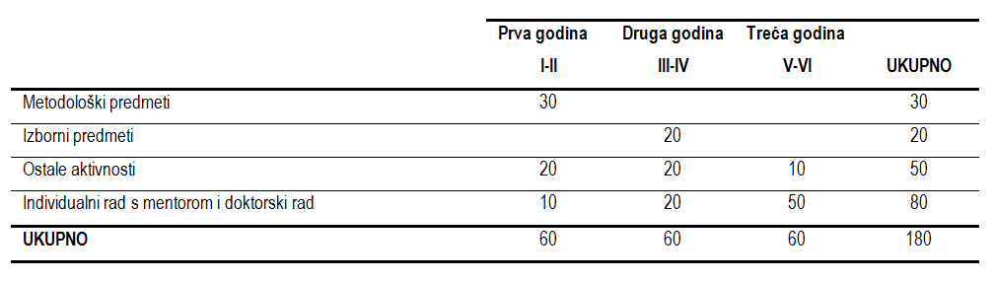
TRIBE ECTS system

Slide 8
1. godina - PREDMETI
Kod | Naziv predmeta | Nastava P + S +V | ECTS
ZOP1 PT001 PT-ZOP1 | Uvod u znanstveni rad (prof.dr.sc. Matko Marušić) | 6+6+0 | 2
ZOP2 PT002 PT-ZOP2 | Opća biostatistika (doc.dr.sc. Ozren Polašek) | 4+4+8 | 2
ZOP3 PT003 PT-ZOP3 | Pisanje znanstvenog članka (doc.dr.sc. Livia Puljak) | 10+4+10 | 3
ZOP4 PT004 PT-ZOP4 | Izrada plana istraživanja (prof.dr.sc. Matko Marušić) | 0+20+0 | 3
ZOP5 PT005 PT-ZOP5 | Pisanje znanstvenih projekata (prof.dr.sc. Ivica Grković) | 2+13+0 | 2
ZOP6 PT006 PT-ZOP6 | Procjena vrijednosti znanstvenog članka (doc. dr. sc. Livia Puljak) | 8+8+0 | 2
ZOP7 PT007 PT-ZOP7 | Etika u istraživanjima (prof.dr.sc. Ana Marušić) | 6+0+4 | 2
ZOP8 PT008 PT-ZOP8 | Pretraživanje medicinskih informacija (prof.dr.sc. Damir Sapunar) | 2+6+6 | 2
OP1 PT009 PT-OP1 | Organizacija i sigurnost laboratorijskog rada (prof.dr.sc. Damir Sapunar) | 8+6+4 | 3
OP2 PT010 PT-OP2 | Pokusne životinje i životinjski modeli (dr.sc. Natalija Filipović) | 10+4+4 | 3
OP3 PT011 PT-OP3 | Metode molekularne i stanične biologije (prof.dr.sc. Maja Pavela Vrančić) | 4+4+6 | 2
OP4 PT012 PT-OP4 | Poduzetništvo i transfer tehnologija (prof.dr.sc. Mile Đelalija) | 10+10+5 | 3
BS26 PT024 PT-IP11 | Komunikacijske i prezentacijske vještine (doc.dr.sc. Livia Puljak) | P8+6V | 2
 |  |  | 30

Slide 9
2. godina
IZBORNI PREDMETI TRIBE STUDIJA
Kod | Naziv predmeta | Nastava | ECTS
PT014 PT-IP1 | Zagonetka boli | P10+S4 | 2
BS02 | Istraživanja ljudskih embrija: etički, metodološki i razvojni principi | P6+S4+V4 | 2
BS03 | Glikobiologija hematopoeze | P2+S4+V10 | 2
BS04 | Glikobiologija imunološkog sustava | P4+S6+V5 | 2
BS05 | Molekularne interakcije organskih sustava: osteoimunologija | P3+S5+V7 | 2
PT015 PT-IP2 | Avanture osjeta boli u mozgu | P10+S6 | 2
BS07 | Genetičke osnove kompleksnih bolesti | P4+S5+V6 | 2
PT016 PT-IP3 | Gledanje nevidljivog | P10+V6 | 2
PT018 PT-IP5 | Razvoj spinalnih ganglija čovjeka | P6+S4+V4 | 2
BS10 | Kopljača – Model za evoluciju Chordata | P5+S5+V5 | 2
BS11 | Osnove srčane elektrofiziologije i bioenergetike | P3+S5+V7 | 2
BS12 | Rak debelog crijeva | P4+S6+V5 | 2
PT019 PT-IP6 | Genetička statistika i genomske baze podataka | P4+S4+V4 | 2
PT020 PT-IP7 | Plasticitet neurokemijskog fenotipa | P6+S2+V4 | 2
PT021 PT-IP8 | Dijagnostika genskih i kromosomskih poremećaja | P7+S4+V4 | 2
BS16 | Oksidativni stres i mehanizmi zaštite–uloga mokraćne kiseline | P6+S4+V5 | 2
BS17 | Multivarijantna statistika | P4+S6+V4 | 2
BS18 | Zašto i kako dišemo? | P6+S5+V14 | 2
BS19 | Životinjski modeli u istraživanju moždanog udara | P6+S4+V4 | 2
BS20 | Kvazieksperimentalne i neeksperimentalne metode istraživanja | P10+S10 | 2
BS21 | Komunikacije u živim organizmima | P6+S4+V4 | 2
BS22 | Uloga ubikvitina i autofagije u zdravlju i bolesti | P4+S6+V5 | 2
BS23 | Koncepti medicinske genetike | P3+S5+V7 | 2
PT022 PT-IP9 | Translacijska istraživanja slušanja i govora | P10+S6+V4 | 2
PT023 PT-IP10 | Cochrane knjižnica i dokazi u medicini | P5+5S+5V | 2
PT013 PT-OP5 | Metode izolacije bioaktivnih tvari | 10+6+0 | 2
PT-IP13 | Drug discovery | 5+10+0 | 2
 | Preoperativno i intraoperativno mapiranje elokventnih regija kore mozga | 6+4+4 | 2

Slide 10
Extracurricular activities
List of required extracurricular activities and the corresponding number of ECTS:
- Dva rada objavljena u časopisu indeksiranom u CC-u s čimbenikom odjeka višim od 1. Pristupnik mora biti prvi autor na oba rada (15 ECTS bodova). Jedan rad mora biti izravno povezan s temom doktorskog rada.
- Two papers published in journals indexed in CC with an impact factor above 1. At least one of these two papers must be related directly to the PhD thesis proposal (15 ECTS per paper).
- Tri annual reports on mentor (supervisor) and candidate progress presented and accepted on the Council meeting (3 ECTS).
- Tri godišnja izvješća o napretku mentora i pristupnika prezentirana i prihvaćena na Vijeću (5 ECTS bodova, ukupno 15 ECTS bodova).
- At least 3 presentations / seminars (journal club) (3 ECTS total).
- At least 3 presentations / seminars on subject related to research in which the graduate student is involved (3 ECTS total).

Slide 11
Some of the extracurricular activities and their ECTS:
- Dodatni znanstveni rad objavljen u časopisu indeksiranom u CC-u
(prvo autorstvo 10 ECTS bodova, koautorstvo 5 ECTS bodova)
- Sudjelovanje na međunarodnom kongresu (kongresno priopćenje): usmeno izlaganje
(3 ECTS boda), poster prezentacija (1 ECTS boda).
- Sudjelovanje na domaćem kongresu (kongresno priopćenje): usmeno izlaganje
(1 ECTS bod), poster prezentacija (0.5 ECTS boda).
- Sudjelovanje na domaćim, domaćim s međunarodnim sudjelovanje, ili međunarodnim znanstvenim seminarima, tečajevima, konferencijama, ljetnim školama i sl.
(0.2 – 5 ECTS boda).
- Pohađanje predavanja i seminara koje organizira Ured za znanost
(0.5 ECTS boda predavač, 0.2 ECTS boda slušač)

Slide 12
Mentor
The PhD and Specialist thesis mentor (supervisor) is a teacher or a researcher holding a research and teaching rank or research rank respectively.
At the time of appointment, the mentors (supervisors) must have scientific achievements in the last five years which include at least three papers from the corresponding research field published in journals indexed in Current Contents (CC).
With the aim of ensuring the quality of final thesis, the supervision can be granted to researchers outside the School who sign an Agreement of Cooperation and Responsibilities.

Slide 13
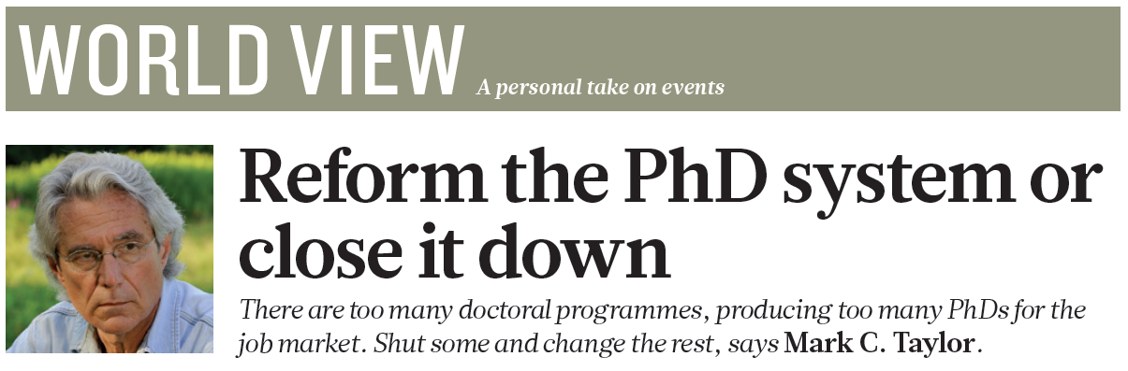
Taylor M. Reform the PhD system or close it down. Nature 472, 261 (2011)
In many fields, it creates only a cruel fantasy of future employment that promotes the self-interest of faculty members at the expense of students. The reality is that there are very few jobs for people who might have spent up to 12 years on their degrees.
But in far too many cases, specialization has led to areas of research so narrow that they are of interest only to other people working in the same fields, subfields or sub-subfields.

Slide 14
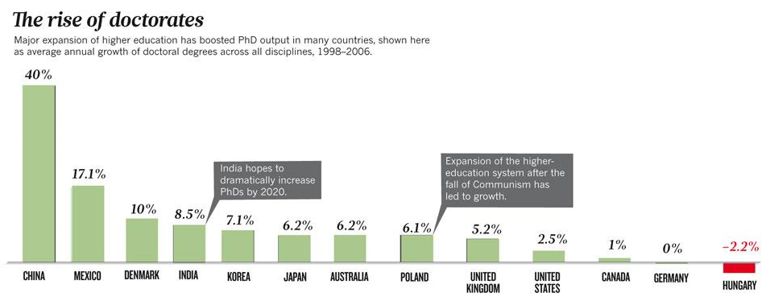
Education: The PhD factory
Cyranoski D. et al. Nature 472, 276-279 (20 April 2011)
Notes:
This means there are few jobs for the current crop of PhDs. Of the 1,350 people awarded doctorates in natural sciences in 2010, just over half (746) had full-time posts lined up by the time they graduated. But only 162 were in the academic sciences or technological services,; of the rest, 250 took industry positions, 256 went into education and 38 got government jobs.

Slide 15
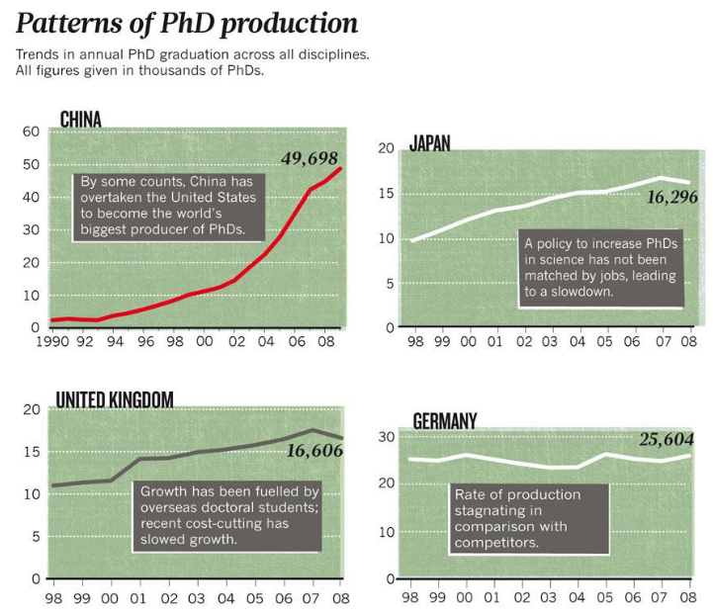

Slide 16
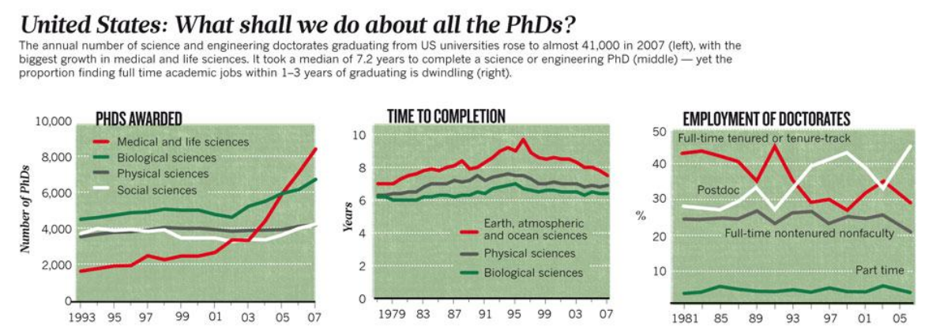
Notes:
US: More than 100 000 PhD degrees were awarded between 2005 and 2009 but there were only 16 000 new profesorship.
Sanse za dobivanje posla na fakultetu za postdokove nisu velike, otprilike 1:5.

Slide 17
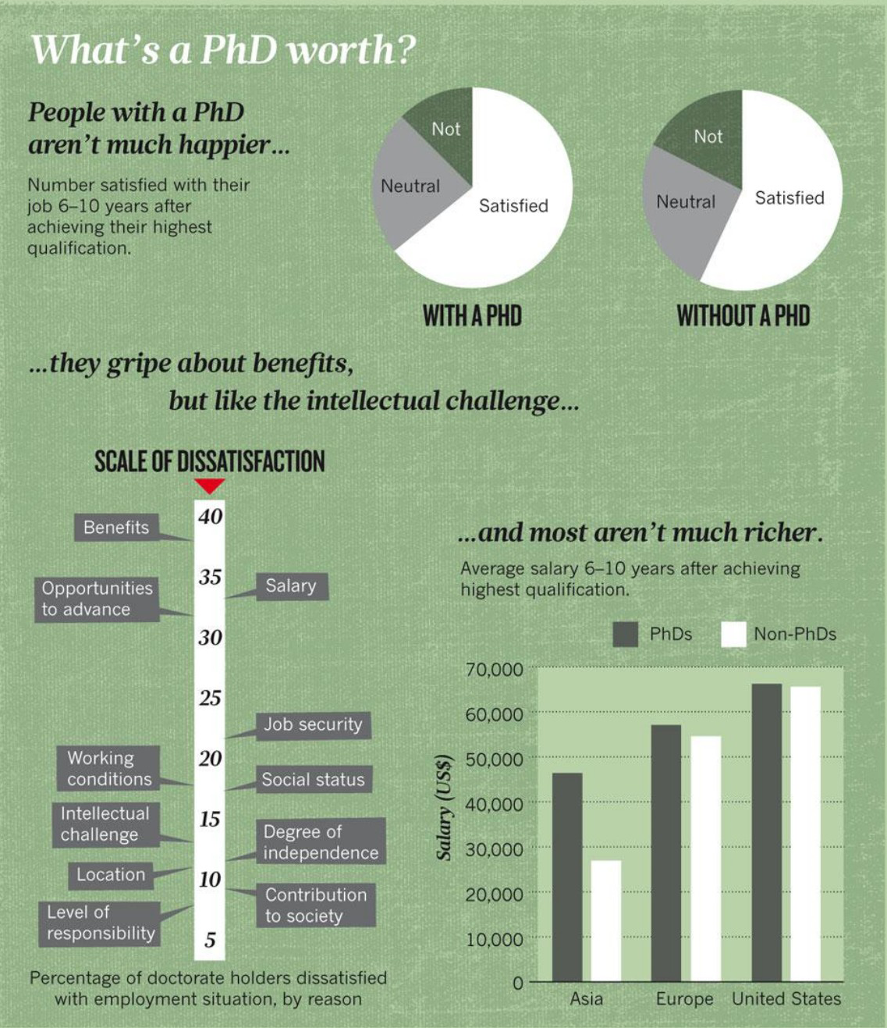

Slide 18
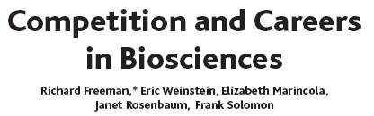
Career patterns in bioscience research
Tournament model
- Equal chances of winning a prize
- Turning small differences in productivity in huge differences in recognition and awards
- High competitiveness
Notes:
Freeman polazi od temeljnog: ponuda i potražnja.
Većina od 150 000 američkih znanstvenika u biomedicini radi na sveučilištima i koleđima.
US vlada je glavni financijer biomedicinskih istraživanja. Ona utječe na zapošljavanje istraživaća, postdokova, primanjem studenata iz inozemstva. Istodobno, vlada određuje i potrebu za istrživakom aktivnošću dodjeljujući projekte.
Turnament model
Kao i u sportu…sudionici igre imaju šansu za veliki dobitak.U ovom slučaju nagrada je neovisna istraživačka karijera, stalna pozicija, profesura, nagrade i slicno. Nažalost ovaj model potiće kompetitivnost tako što amplificira i transponira male razlike u produktivnosti u velike razlike u priznavanju i nagrađivanju. Ovo inducira veliku kompetitivnost. Otprilike 1/3 PhD u life sciences radi 60 ili vise sati tjedno. Turnament model rezultira i short citation rates pa zbog toga ljudi ne mogu napraviti prekid u karijeri. Izmedu 1990 i 95 bioscientist su publicirali 6.5 radova u usporedbi s 4.7 radova u drugim područjima. Kada napravimo korelaciju radnog vremena i broja publikacija ispada da 5 sati vise rada tjedno tijekom godine nosi jednu publikaciju vise (ali u US i nbesto vecu palcu 1%)

Slide 19
To facilitate change, universities should move away from excessive competition fuelled by pernicious rating systems, and develop structures and procedures that foster cooperation. This would enable them to share faculty members, students and resources, and to efficiently increase educational opportunities. Institutions wouldn’t need a department in every field, and could outsource some subjects. Teleconferencing and the Internet mean that cooperation is no longer limited by physical proximity.

Slide 20
The EU will need to create at least 1 M new research jobs in order to reach R&D intensity of 3%.
The net increase by two thirds of the number of EU researchers by 2020 should primariliy benefit the bussines sector.

Slide 21
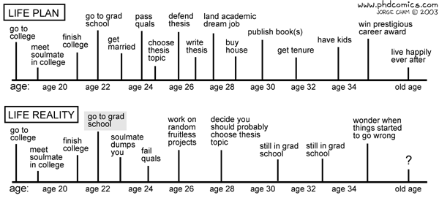
Notes:
Don’t get me wrong. Every scientist goes on to do science for a single reason: the love of science. Science doesn’t make you rich, it doesn’t make you famous (can you tell me the last 5 Nobel Prizes for chemistry without looking on Wikipedia? I can’t either) and doesn’t make you comfortable. The only sane reason for starting to do science is the dispassionate love of science itself. And I loved science. Like nothing else. Since I was 5 years old. And I still love it.
But one thing is to love science; a completely different one is doing it. Like the proverbial sausage, you don’t want to know how it’s done.
http://blog.devicerandom.org/2011/02/18/getting-a-life/

Slide 22
Christian de Duve
The Nobel Prize in Physiology or Medicine 1974
Using simple logic: application presupposes discovery, and discovery requires research, and research implies exploring the unknown, with, by definition, the inability to predict how useful or profitable whatever will be found could turn out to be.
Science is one field of human endeavor that must be unashamedly elitist. You cannot seek the truth with poor thinking or sloppy techniques.
In conducting your research, observe total rigour and intellectual honesty in the analysis of facts, consider all possible hypotheses, plan your approach to test those hypotheses, and submit your conclusions to the verdict of observation and experimentation without preconceived ideas. Never conduct research with the aim of proving a theory, but, rather, to invalidate it if it should be wrong. The best proof is failure to disprove.
Aside from as a Nobel laureate, how do you want the world to be remember you?
I have no such ambition. In the history of science, my contributions are minor and would have been made by someone else had I not stumbled on them first.

Slide 23
George Smoot
Nobel Prize 2006 in Physics
Biological systems are so complex and so poorly observed and measured that biologists had to be satisfied by a high level and rough understanding of what they were studying, while physicists are trained for rigor and precision.
Aside from as a Nobel laureate, how do you want the world to remember you?
I do not think the world will remember any of us. When you work in cosmology, you think with a perspective of billions of years. How many people do we remember from 1,000 years ago? How many from 10,000 years ago? How many from 1 million years ago? etc. So now the question is more like that about Ozymandias [from Percy Shelley’s poem]. After a thousand or so years nothing is left of the great works but a few broken relics. What will be left in a billion years?
The point is not about being remembered or about doing science to win a Nobel prize — you do science because you want to be a scientist. Likewise, you live your life in a way you think is good and good for you.

Slide 24
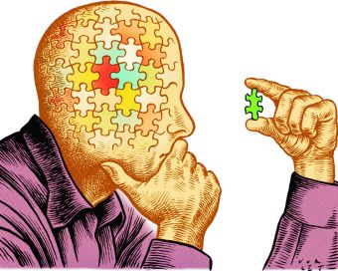
Critical thinking

Slide 25

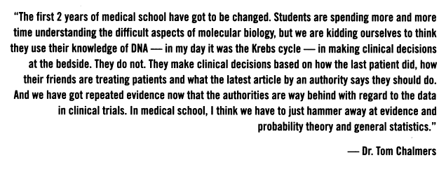
Notes:
Dr. Thomas Chalmers, an American physician who played a pivotal role in the scientific development of the randomized control trial and meta-analysis.
CMAJ. 1996 September 15; 155(6): 757–760.

Slide 26
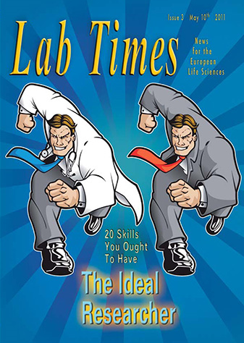
Skills and competencies needed in the research field – Objectives 2020
Notes:
- French employment agency commission an international survey exploring.
- Europe 2020’ the latest pan-European strategy for developing a “knowledge economy”.

Slide 27
Questionnaire:
Are you the Ideal Researcher?
In this exercise, we are testing for the key essential qualities.
Rate your skills on a 3-point scale
0 points - What skill? I’ve never thought about this before.
1 point - It’s occasionally been known to happen.
2 points - I’m an expert at this.

Slide 28
Scientific Skills
A1. My computer and I are inseparable. It does exactly what I ask of it and I can even repair it. I’ve also tweaked programme codes. I can relate to my computer.
A2. I have talked to researchers from other disciplines about more than just the weather.
0 points - What skill? I’ve never thought about this before.
1 point - It’s occasionally been known to happen.
2 points - I’m an expert at this.

Slide 29
B. Management Skills
B1. I can ask other researchers if they’d like to interact with me and find common ground for research.
B2. I know how much lab supplies cost. I have a system for purchasing lab products at the best price, thereby maximizing the lab’s limited funding resources. I even know where to exchange our surplus with other labs if needed.
B3. I recognize that scientific experiments are only one tiny part of a huge process that requires me to go around asking for money, work out how to spend it and finally claim to have spent it well before asking for more money again.
B4. At social gatherings with non-scientists, I can explain why my research is important for them, their children and their children’s children, although I rarely do this anymore because people stop talking to me.
0 points - What skill? I’ve never thought about this before.
1 point - It’s occasionally been known to happen.
2 points - I’m an expert at this.

Slide 30
C. Personal Qualities
C1. I am bubbling over with new ideas.
C2. I have difficulty sleeping at night whilst preoccupied with the search for novel solutions to experimental problems. I frequently doodle my flashes of inspiration in my lab book and on envelopes, beer mats, tax returns, etc.
C3. I often hum, whistle or tap rhythmically in the lab.
0 points - What skill? I’ve never thought about this before.
1 point - It’s occasionally been known to happen.
2 points - I’m an expert at this.

Slide 31
Your Scores
Zero A and B points: APEC (or your own national employment agency) doesn’t know how you became a researcher. What kind of researcher are you, anyway? Probably someone who hates accountants, loathes administration and bins bureaucracy. You are either too original, independent or antisocial to require their services.
4 A points: Good with computers and technical figures. APEC asks whether you’ve ever thought of becoming an accountant or management consultant? Don’t forget that they deal in money and know how to make big salaries (and bonuses). Make the transition from an undervalued lab coat to an overvalued suit!
More than 5 B points: Good administrative scores. You’re no doubt sensitive to the relevance of research in the current social environment. Have you considered the human resources? APEC needs responsive, professional employment counsellors to manage its growing pool of scientifically-qualified job-seekers.
6 C points: Too creative! Oh dear, you chose creativity – these are trick questions. Although Deloitte listed creativity as one of the 20 qualities in an ideal researcher, it was not rated as one of the 6 ‘key’ skills for the future – you’re not keeping up with the trends. APEC will probably advise you to retrain as an art teacher or to learn jazz.
Maximum A and B points: Congratulations! You’re one of Deloitte’s ideal researchers! In this spirit, APEC will observe the report’s other recommendations and advise you to choose international mobility, taking a risky job with a high career growth potential in another country.

Slide 32
The full range of identified skills are:
Scientific: scientific knowledge; the ability to learn and adapt; the capacity to formulate a research problem; the ability to analyse and master computer skills to a high technical level; the ability to work in an interdisciplinary environment; and the capacity to integrate existing knowledge.
Personal: creativity; an open mind; motivation and involvement; adaptability; and the capacity to self-evaluate.
Management: the ability to work in a team; communication skills; the capacity to develop a network; a capacity to evaluate; language skills; an enterprise (business) culture and management skills; project management; team management and direction; and the ability to take account of the relevance of one’s research and its impact on the environment.

Slide 33
The 6 key skills (according to the APEC-Deloitte survey):
analysis and mastery of computers and sophisticated IT tools
the ability to work with researchers from other disciplines (interdisciplinarity)
can develop a ‘network’
possession of an ‘enterprise/business culture’ and management skills
- project management
and,
finally, the single most important quality in the ideal researcher of the future:
- awareness of the pertinence of the research and its impact on the environment.

Slide 34
Literature
Reform the PhD system or close it down
Mark Taylor
Nature 472, 261-261 (20 April 2011)
Education: The PhD factory
David Cyranoski, Natasha Gilbert, Heidi Ledford, Anjali Nayar, Mohammed Yahia
Nature 472, 276-279 (20 April 2011)
Reform the PhD system or close it down
Mark Taylor
Nature 472, 261-261 (20 April 2011)
Education: The PhD factory
David Cyranoski, Natasha Gilbert, Heidi Ledford, Anjali Nayar, Mohammed Yahia
Nature 472, 276-279 (20 April 2011)
Seven ages of the PhD
Raymond Gosling, Cheryll Tickle, Steve W. Running, Yao Tandong, Andras Dinnyes, A. A. Osowole, Erika Cule
Nature 472, 283-286 (20 April 2011)

Slide 35
Tools
http://graduate-school.phds.org/
http://sites.nationalacademies.org/PGA/Resdoc/index.htm

